Slide 1
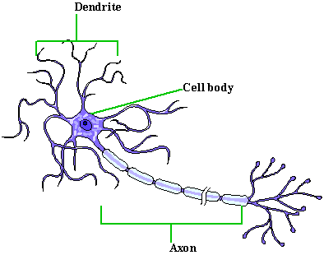
The Nervous System : communication
A. Neurons = masses of nerve cells that transmit information
1. Cell Body - contains the nucleus and two extensions 2. Dendrites – shorter, more numerous, receive information 3. Axons – single, long “fiber” which conducts impulse away from the cell body, sends information

Slide 2
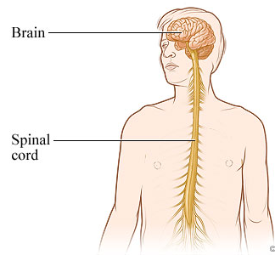
Central Nervous System (CNS): brain and spinal cord.
Peripheral Nervous System (PNS): nerves of the body
-- Includes 31 pairs of spinal nerves
-- And 12 pairs of cranial nerves

Slide 3
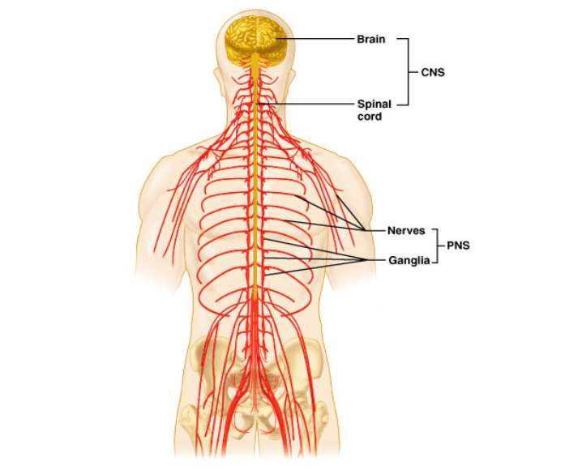
Basic Divisions of the Nervous System
Figure 12.2

Slide 4
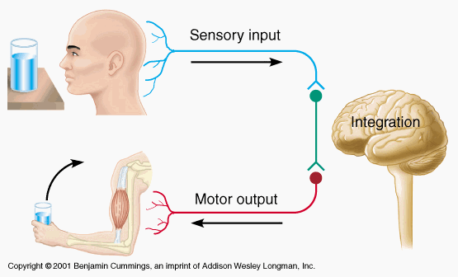
THREE BASIC FUNCTIONS OF THE NERVOUS SYSTEM
Sensory - gathers info
Integrative - information is brought together
Motor - responds to signals, homeostasis

Slide 5
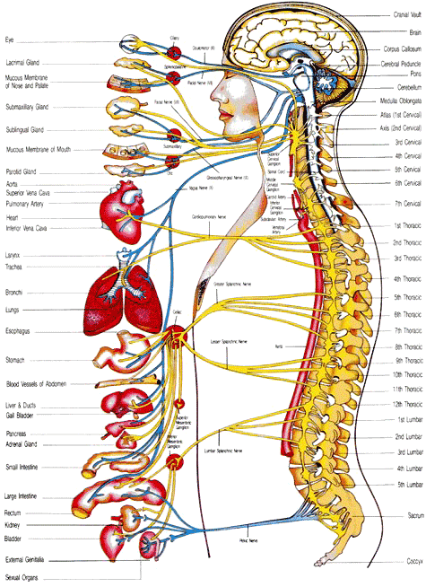
Motor Functions
Somatic Nervous System - skeletal (voluntary)
Autonomic Nervous System - smooth muscles, glands (involuntary)

Slide 6
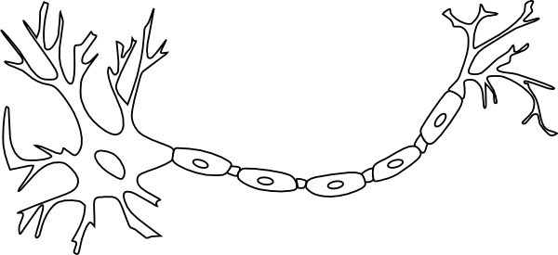
Neurons = nerve cells
1. Dendrites - receive information
2. Axons - conducts impulses

Slide 7
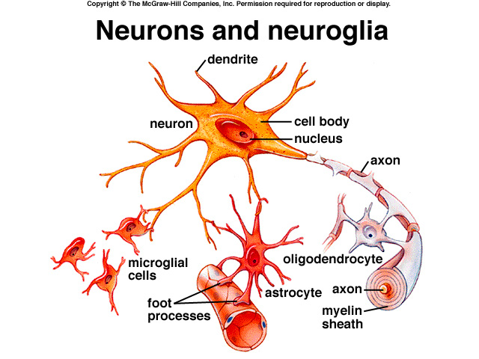
Neuroglial Cells
- support cells for the neurons

Slide 8
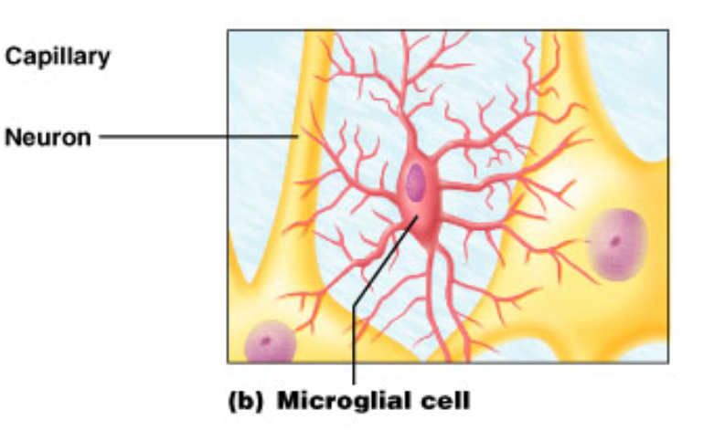
Neuroglial Cells
1. Microglial Cells: digest debris or bacteria
Microglial cells respond to immunological alarms

Slide 9
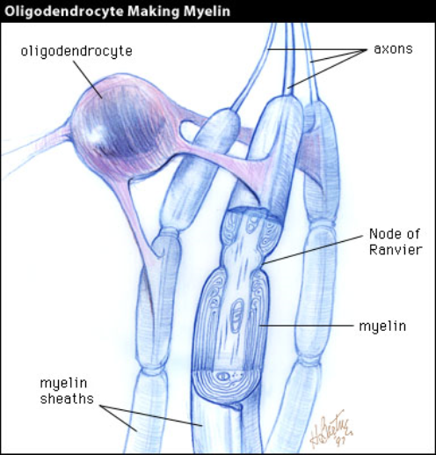
Neuroglial Cells
2. Oligodendrocytes:
makes the myelin sheath that
provides insulation around the axons

Slide 10
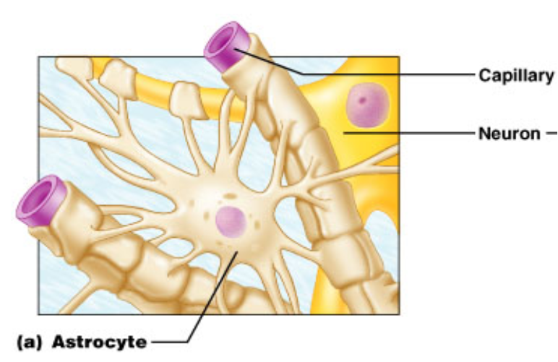
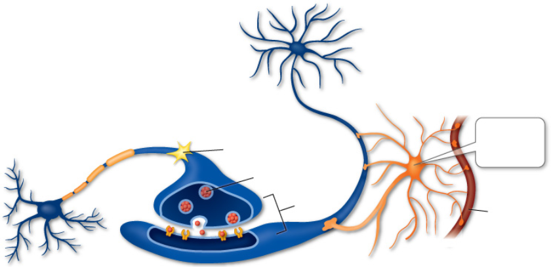
Neuroglial Cells (p 208)
3. Astrocytes: connect blood vessels to neurons
I connect to blood vessels

Slide 11
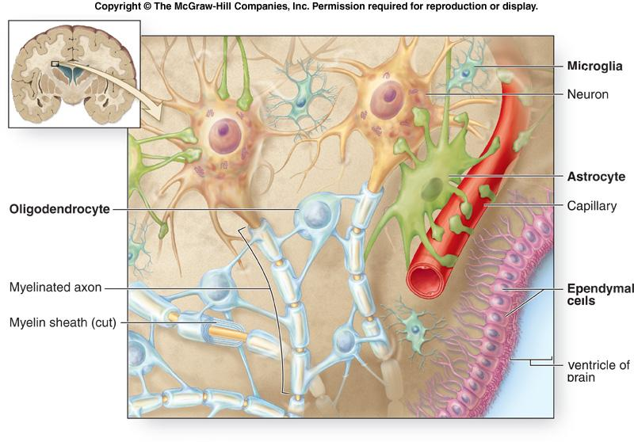
4. Ependymal Cells: forms a membrane

Slide 12
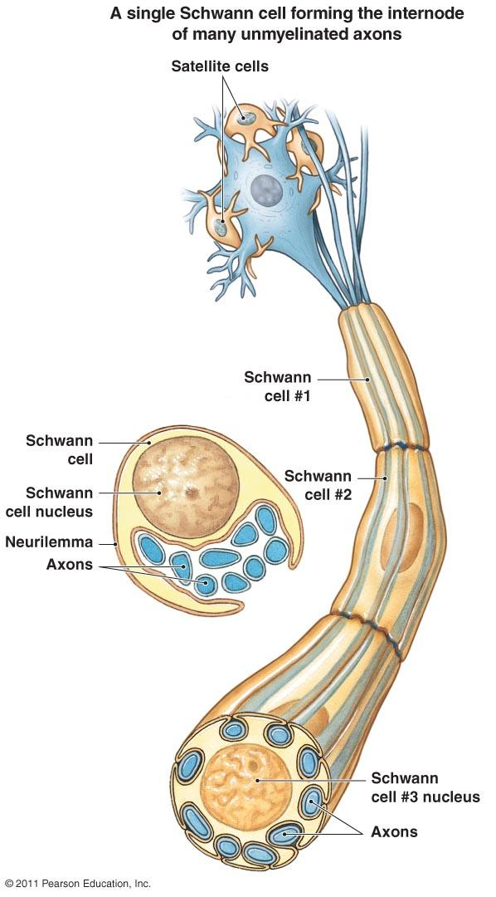
5. Schwann cells: form the insulating myelin sheath around the neurons

Slide 13
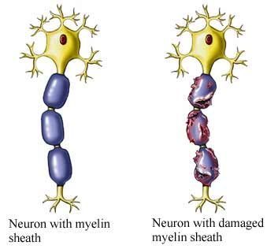
MYELIN SHEATHS
- these serve as insulation around the axon
Schwann cells supply the myelin for peripheral neurons.
Oligodendrocytes myelinate the axons of the central nervous system.
Practice with neuroglia coloring!

Slide 14
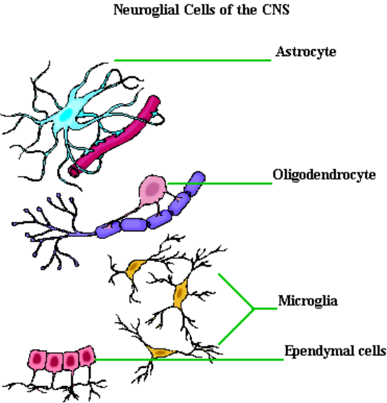
Supporting Cells - NEUROGLIA

Slide 15
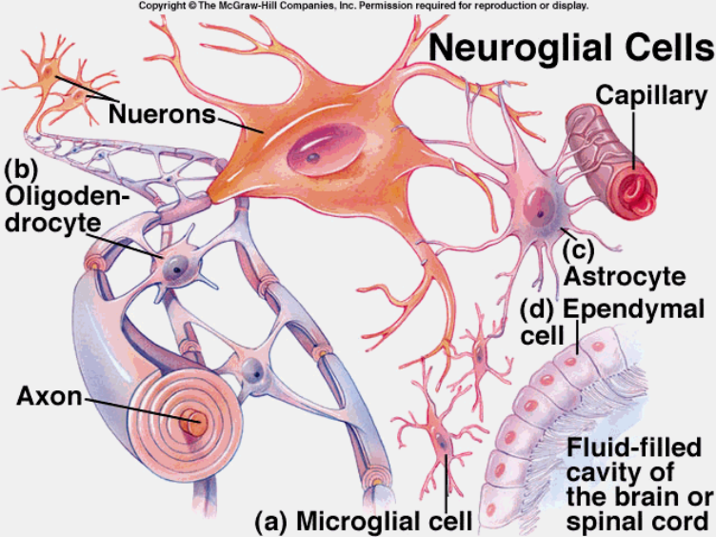
Supporting Cells- NEUROGLIA

Slide 16
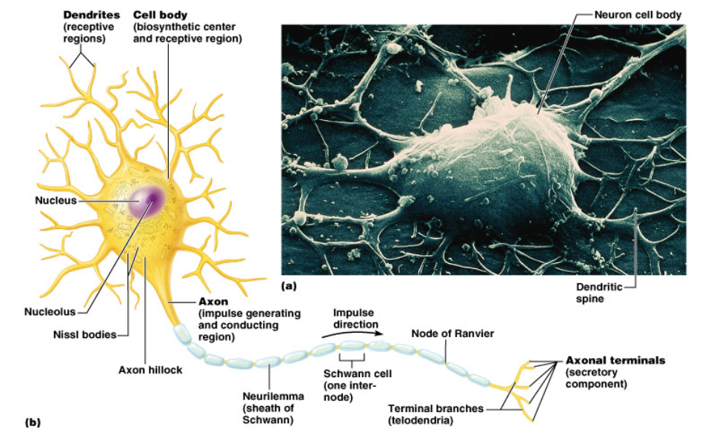
Neurons
Axon - long section, transmits impulses
Dendrite - extend from the cell body; receive information
Neurofibrils - fibers within the axon

Slide 17
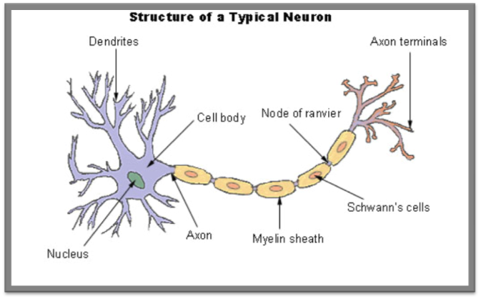
Chromatophilic substance (rough ER) - transport system
Myelin -insulation surrounding axons
Nodes of Ranvier - gaps in the insulation
chromatophilic
substance

Slide 18
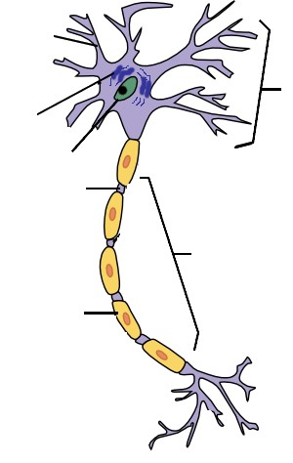
Dendrites
Chromatophilic substance
Nucleus
Node of Ranvier
Axon
Myelin Sheath

Slide 19
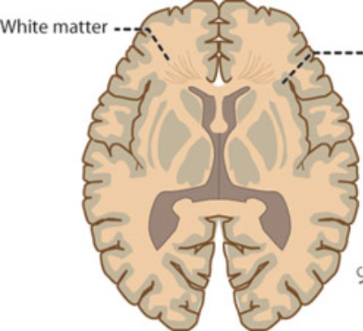
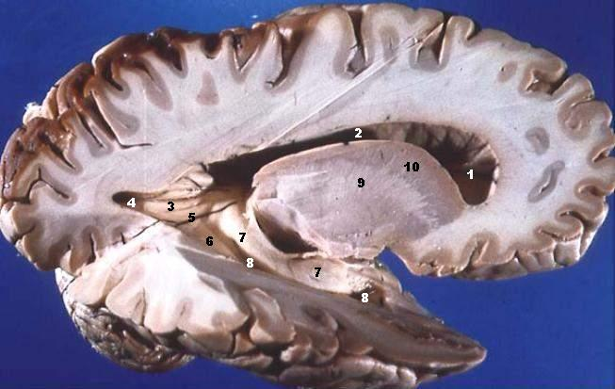
White vs Grey Matter
Myelinated (white matter) – myelinated axons
Unmyelinated (grey matter) - unmyelinated

Slide 20
Classification of Neurons
Functional:
Sensory - receives information from senses
Motor - send information to muscles, organs, glands
Interneurons - relay information

Slide 21
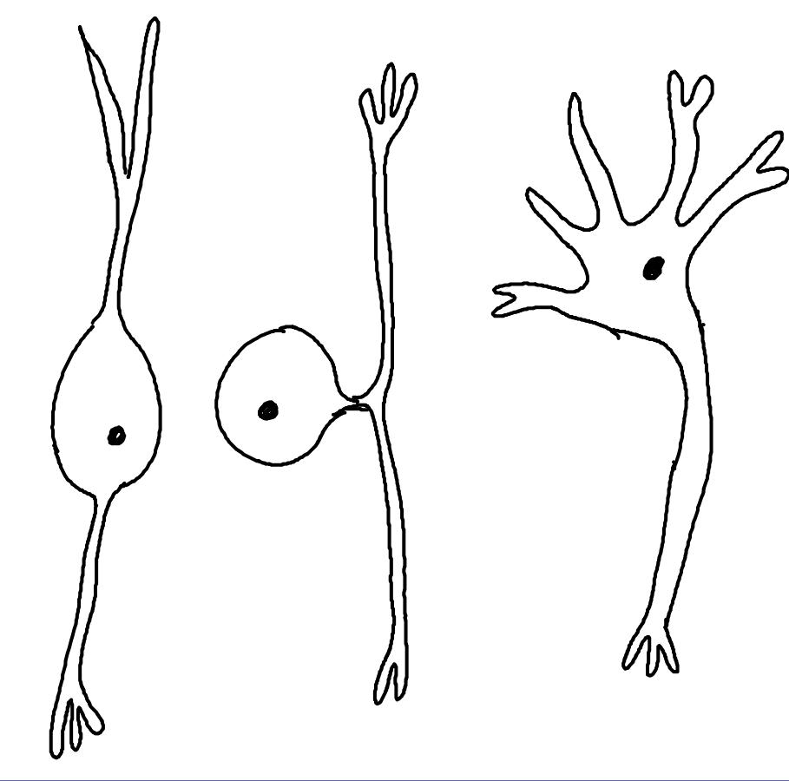
Structural: (A) Bipolar (B) Unipolar (C) Multipolar

Slide 22
Interesting Facts about the Neuron
Longevity – can live and function for a lifetime
Do not divide – fetal neurons lose their ability to undergo mitosis; neural stem cells are an exception
High metabolic rate – require abundant oxygen and glucose
The nerve fibers of newborns are unmyelinated - this causes their responses to stimuli to be coarse and sometimes involve the whole body. Try surprising a baby!

Slide 23
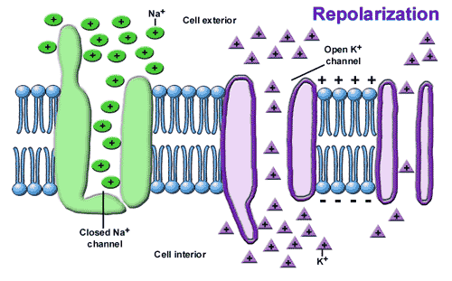
Cell Membrane Potential
Resting Potential / Threshold Potential / Action Potential
Nerve Impulse = weak electric current.

Slide 24
1. Neuron membrane maintains resting potential
2. Threshold stimulus is received
3. Sodium channels open
4. Sodium ions diffuse inward, depolarizing the membrane
5. Potassium channels open
6. Potassium ions diffuse outward, repolarizing the membrane
7. The resulting action potential causes a local bioelectric current that stimulates adjacent* portions of the membrane.
8. Wave of action potentials travel the length of the axon as a nerve impulse
* What does the word “adjacent” mean?

Slide 25
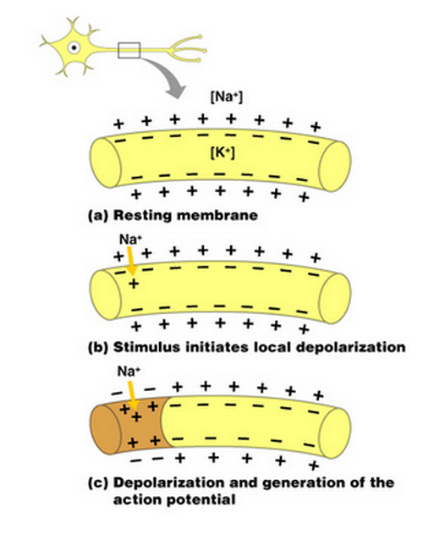
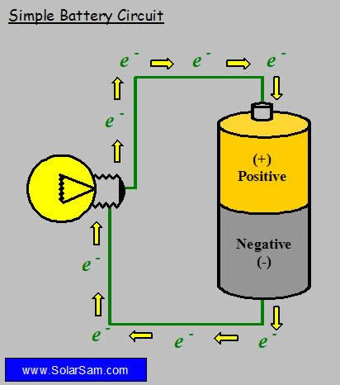
Ions in the cell and outside the cell create a positive and negative side, which produces an electric current.

Slide 26
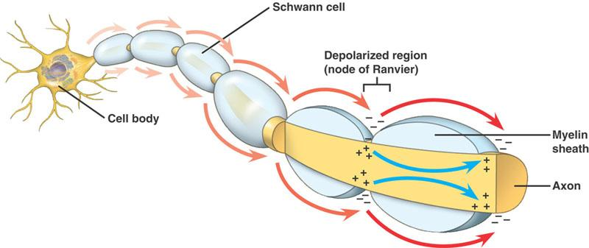
Nerve Impulse
Speed of an impulse is proportionate to the DIAMETER of the AXON.
Greater diameter = faster speed
**Myelinated Axons conduct faster than unmyelinated ones**

Slide 27
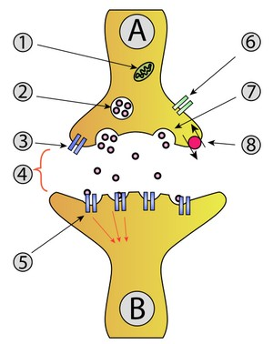
The Synapse
A: Neuron (axon)
B: Neuron (dendrite)
Mitochondria
Vesicle
Receptor
Synapse
Receptor
Calcium Channel
Releases neurotransmitter
Re-uptake

Slide 28
Synapse - junction between two communicating neurons
Nerve pathway - nerve impulse travels from neuron to neuron
Dendrite → cell body → along axon -> synapse (gap) → dendrite

Slide 29
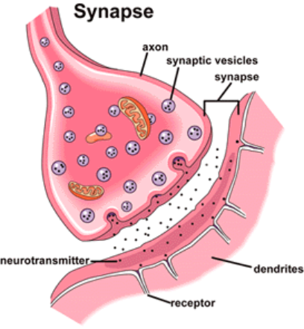
To complete the signal, a NEUROTRANSMITTER is released at the gap to signal the next neuron.
Receptors on the dendrite receive the chemical message

Slide 30
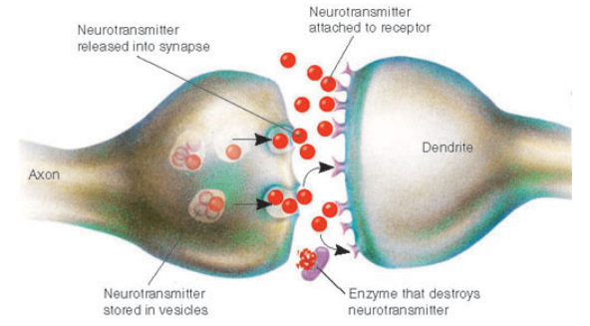
Neurotransmitters
Excitatory - increase membrane permeability, increases chance for threshold to be achieved
Inhibitory - decrease membrane permeability, decrease chance for threshold to be achieved

Slide 31
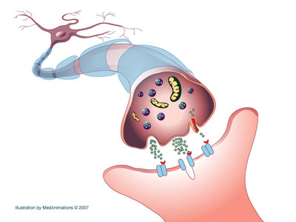
Types of Neurotransmitters
Acetylcholine - stimulates muscle contraction
Monoamines - Norepinephrine & Dopamine (sense of feeling good, low levels = depression)
Serotonin (sleepiness) and mood

Slide 32
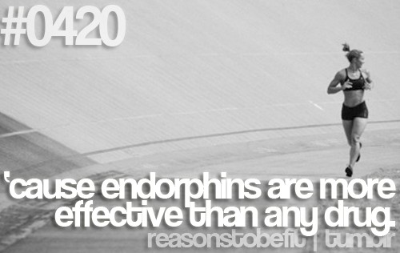
Endorphins = reduction of pain
produced during exercise,excitement, pain, love and they resemble the opiates in their abilities to produce a feeling of well-being.
The name “endorphin” comes from endo- and -orphin; intended to mean "a morphine-like substance originating from within the body.

Slide 33
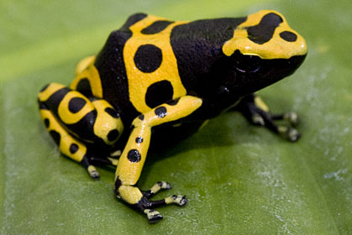
Drugs that Affect Synapses and Neurotransmitters
Curare - poison made from frog skin and causes paralysis by blocking Ach receptors at the neuromuscular junction.

Slide 34
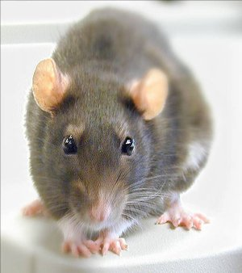
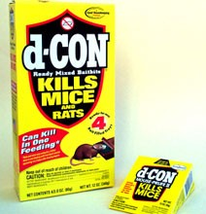
Drugs that Affect Synapses and Neurotransmitters
Strychnine poisoning can be fatal to humans and animals and can occur by inhalation, swallowing or absorption through eyes or mouth
Strychnine is a neurotoxin which acts as an antagonist of acetylcholine receptors. It primarily affects the motor nerves in the spinal cord which control muscle contraction. An impulse is triggered at one end of a nerve by the binding of neurotransmitters to the receptors.
Read about Strychnine Poisoning

Slide 35
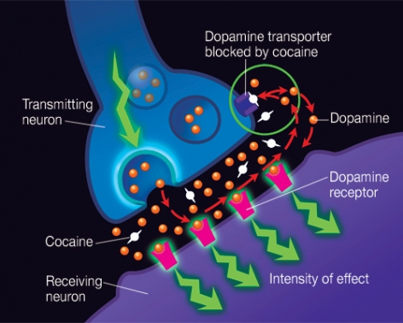
In the normal communication process, dopamine is released by a neuron into the synapse, where it can bind to dopamine receptors on neighboring neurons. Normally, dopamine is then recycled back into the transmitting neuron by a specialized protein called the dopamine transporter. If cocaine is present, it attaches to the dopamine transporter and blocks the normal recycling process, resulting in a buildup of dopamine in the synapse, which contributes to the pleasurable effects of cocaine.

Slide 36
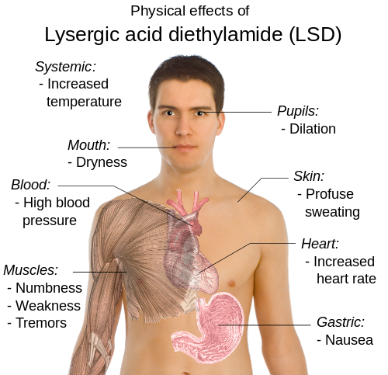
LSD; lysergic acid diethylamide
Actions/Effects: LSD alters the action of the neurotransmitters serotonin, norepinephrine, and dopamine, triggering extreme changes in brain function.

Slide 37
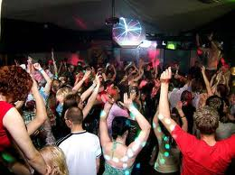
Dangers of Ecstasy (MDMA)
The most common cause of Ecstasy-related death is overheating (hyperthermia). MDMA interferes with the body's ability to regulate its own body temperature and to see other warning signs allowing the body to overheat without discomfort especially when dancing for hours in hot clubs.
The neurotransmitter serotonin is vital in regulating many of our basic functions. Serotonin is, among other things, the feel good neurotransmitter and helps to regulate body temp.
Our brain cells are constantly trying to bring some amount of serotonin back into the cells and out of the synapse using serotonin reuptake transporters.
Ecstasy essentially takes these upkeep transporters and reverses their roles. This causes a massive flood of serotonin from the brain cells into the synapse.

Slide 38
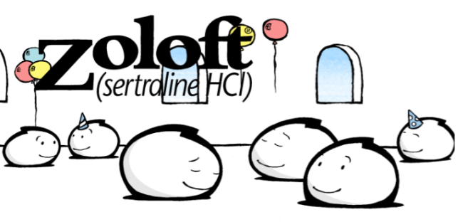
Antidepressants
Zoloft is part of a class of drugs called selective serotonin reuptake inhibitors
--SSRIs act on a specific chemical within the brain known as serotonin.
-- seratonin is associated with mood and sleep

Slide 39
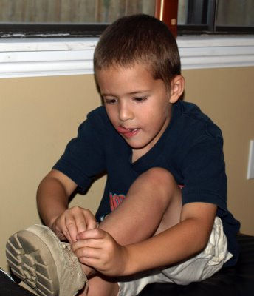
9.8 Impulse Processing
Neuronal pool - groups of neurons that make hundreds of synaptic connections and work together to perform a common function
These "pools" help us remember sequential tasks, like tying a shoe or riding a bike.

Slide 40
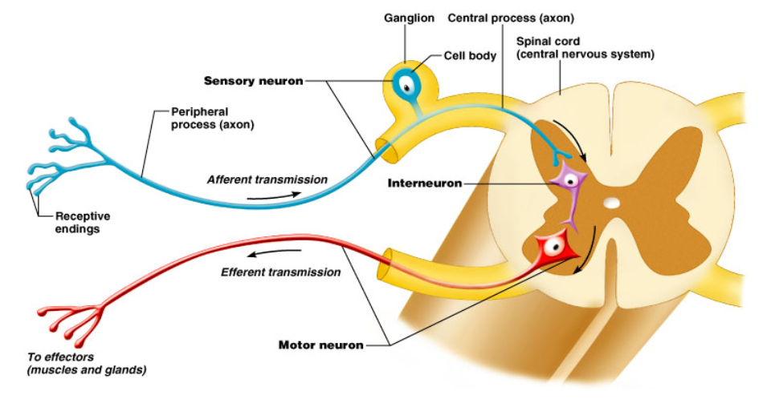
Types of Nerves
Sensory Nerves - conduct impulses into the brain or spinal cord
Motor Nerves - carry impulses to muscles or glands
Mixed Nerves - contain both sensory and motor nerves

Slide 41
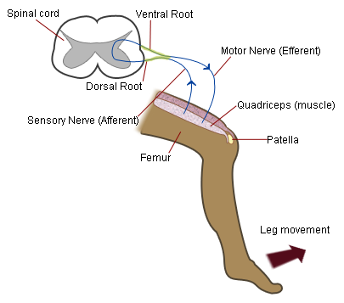
Nerve Pathways
Reflex arc = simple path, only includes a few neurons ( involuntary, instantaneous)
Knee-jerk reflex = maintains uprightedness
Withdrawal reflex = avoidance of painful stimuli

